Slide 1
Well Programs for Homeowners and Noncommunity Systems

Slide 2
Overview of RCAC Well Programs
Clean Drinking Water Well Replacement Program
Decentralized Water System (HWWS) Loan/Grant Program
Individual Well Program

Slide 3
Decentralized Water System Loan/Grant Program
Formerly known as Household Water Well & Septic Loan/Grant Program.
Funded with support from USDA Rural Development.
This Photo by Unknown Author is licensed under CC BY-SA-NC

Slide 4
DWS Eligibility Requirements (Individuals)
Must own and occupy the home.
Household income cannot exceed $37,730 to receive a grant.
New home and small water system construction not eligible.
Must repay in full if home is sold, transferred or leased within 5 years of project completion.

Slide 5
DWS (cont’d)
Provides loans to construct, refurbish, or replace individual water well systems.
Loan Terms
Max Loan: $15,000
Max Term: 20 years
Interest Rate: 1% on first $15,000 cost exceeding may be covered with a grant up to $15,000 total $30,000.

Slide 6
CA Clean Drinking Water Well Replacement Program
This Photo by Unknown Author is licensed under CC BY-NC

Slide 7
CA Drinking Water Well Replacement Grant Program
Financial assistance for drinking water emergencies.
Up to $60,000 for individual wells and $100,000 for small water systems (<15 connections).
*Supported by a grant from the California State Water Resources Control Board.

Slide 8
Eligibility Requirements (Individuals)
Must own and occupy the home.
Household income cannot exceed $62,938 to receive a grant.
New home and small water system construction not eligible.
Must repay in full if home is sold, transferred or leased within 5 years of project completion.

Slide 9
Eligibility Requirements (Small Systems)
Individual households or small systems (less than 15 connections)
Must own and occupy the home or be purchasing the home.
Community water systems not eligible.
MHI of homes may not exceed $62,938. Compared to $37,730 for Decentralized Water System (DWS) loan/grant.

Slide 10
Eligibility Requirements for CA DWWR Program (cont’d)
Proposed work must be completed w/in 1 year of executing grant or loan agreement.
Install treatment devices as necessary to meet State water quality standards.
Payment will be due in full upon sale or transfer of property within 5 years of execution of agreement.

Slide 11
RCAC Loan Fund Contacts
Deborah Almazan
Loan Officer
dalmazan@rcac.org
725-221-0474 cell
775-501-6915 fax
Yeng Lao
Loan Officer
ylao@rcac.org
916-500-1260

Slide 12
Helpful Links
Quick link to Household Well program
https://www.rcac.org/lending-2/household-water-well-septic-loans/
USDA Clean Drinking Water Well Replacement (DWS) Program Flyer
https://www.rcac.org/wp-content/uploads/2019/02/CAAflyer-GrantProgramROUND2-DEB-REV-12-14-18-2-2019.pdf
CA Household Water Well Loan Program Flyer
https://www.rcac.org/wp-content/uploads/2022/10/Clean-Drinking-Water-Well-Replacement-Grant-Program-Flyer-9.28.22.pdf

Slide 13
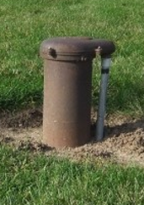
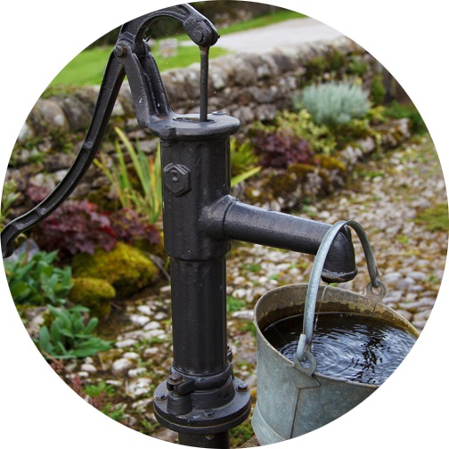
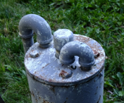
Individual Well Assessment Program
Notes:
New well people in the audience or review of well systems. We have many different types of well head as you can see but the basic components of a well systems are the same.

Slide 14
Benefits of a well Assessment
PROTECTING YOUR DRINKING WATER!
Knowledge
Ability to ask questions
Learn available resources
Understand how well/septic work
Document repairs and upgrades
Report is very useful for new homeowners.
This Photo by Unknown Author is licensed under CC BY-ND

Slide 15
What RCAC will do for you
Research your Well Driller’s Report.
Provide onsite visit
Sketch a map of property
Discuss potential hazards
Offer Best Practices
Provide Well Manual/Resources
Test for coliform, NO3, As
If we don’t know the answer to your question, we’ll find someone who does!

Slide 16
Individual Well Assessment Program
What it is…
What it isn’t…
Well vulnerability assessment.
An Opportunity to:
Understand how your well works
Learn best practices to protect your drinking water.
Identify potential hazards, treatment options
Capture homeowner maintenance/repairs
Map your source, septic system, and points of interest.
A visit to be conducted without homeowner present.
An assessment performed for those who don’t use the well.
Prospective buyers.

Slide 17
Eligibility Restrictions
Well must be used for drinking water. Irrigation wells are not eligible.
Shared well applicants must have legal access to well for assessment.
Have you already received an assessment in past 5 years?
Geography:
Program has limited travel budget.

Slide 18
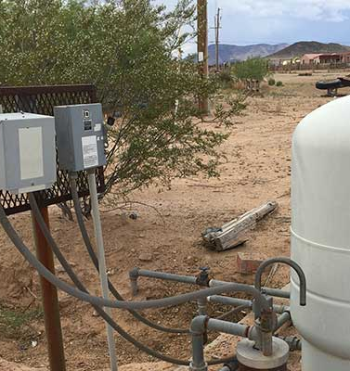
How To Apply. It’s easy!
Program Web Site
https://www.rcac.org/environmental/individual-well-program/
Online Request Form
https://www.rcac.org/environmental/individual-well-program/individual-well-assessment-request/

Slide 19
Individual Well Program Contact
Jeremy Peirsol
Rural Development Specialist
jpeirsol@rcac.org
986-200-1597
Online Request Form
https://www.rcac.org/environmental/individual-well-program/individual-well-assessment-request/

