Slide 1
Sonoma County Drought Outlook
July 7, 2022
Brooke Bingaman
NWS Bay Area
Meteorologist & Climate Lead

Slide 2
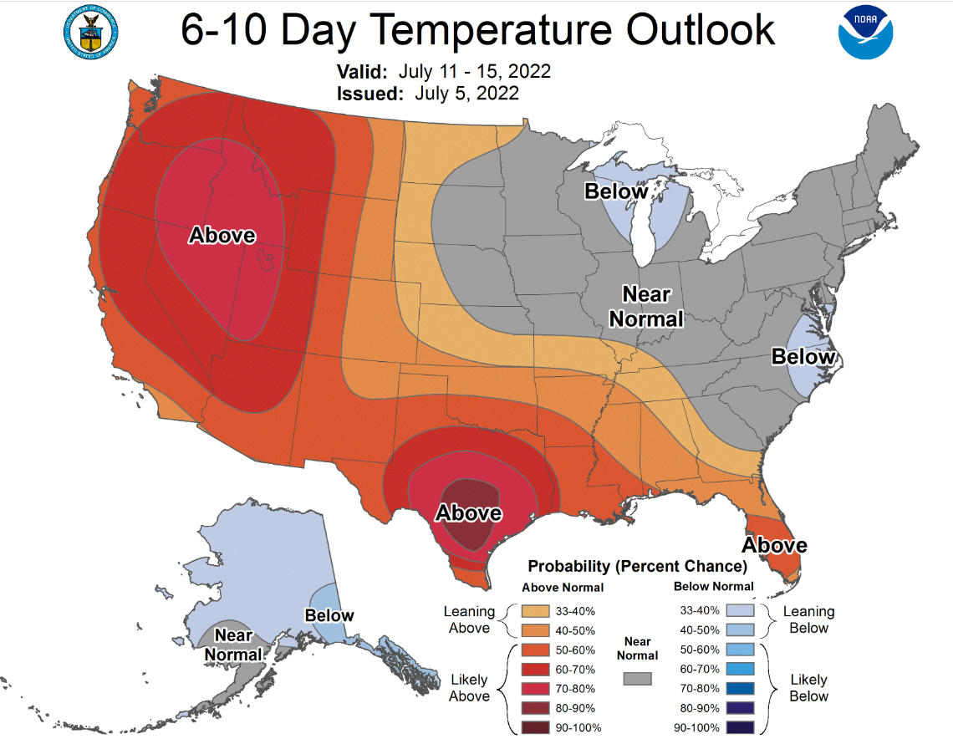
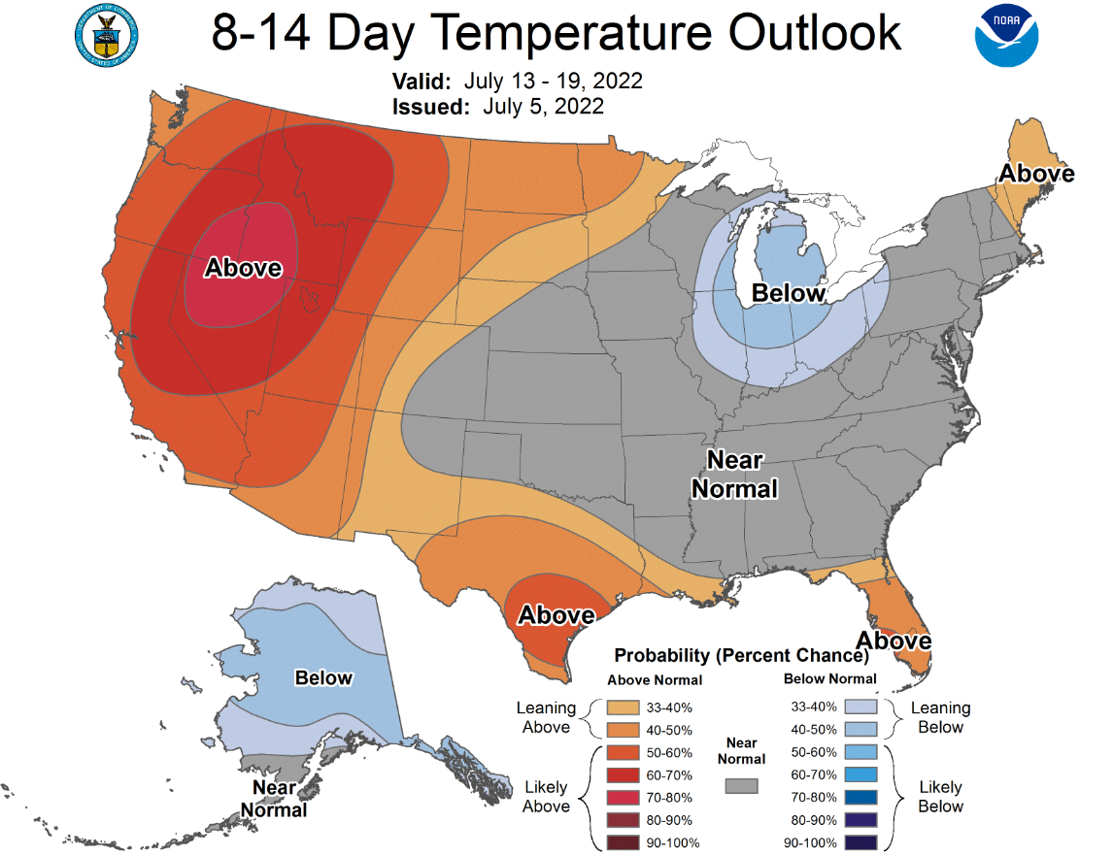
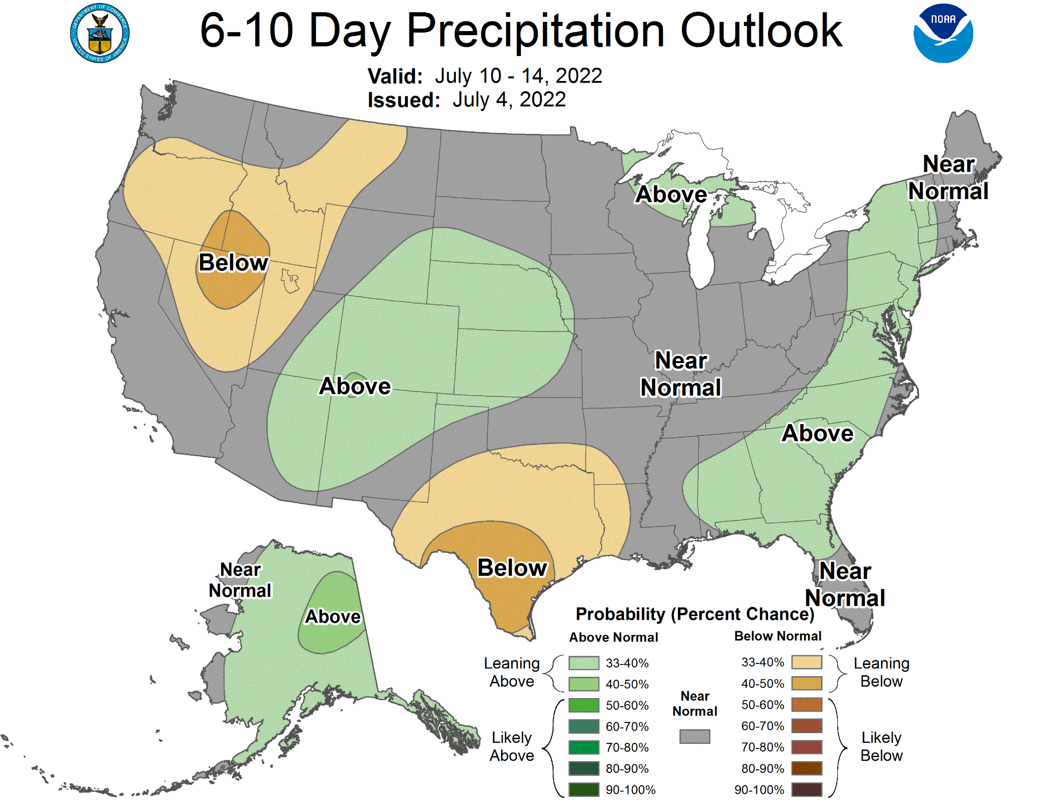
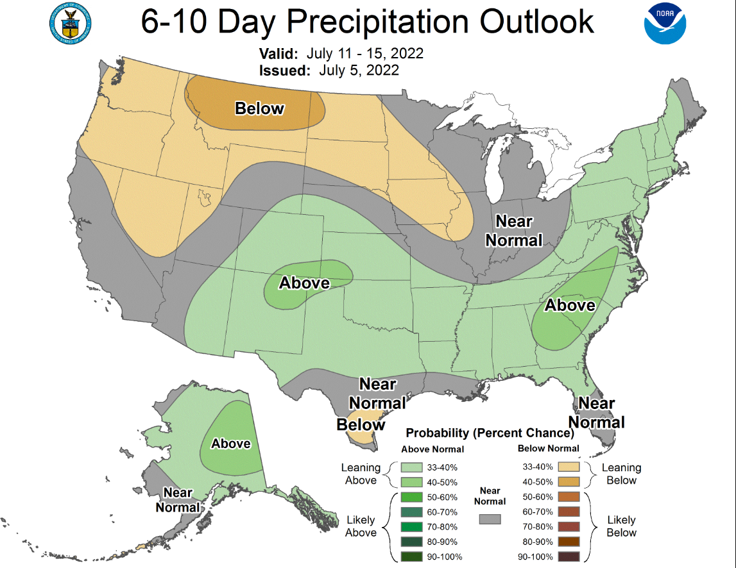
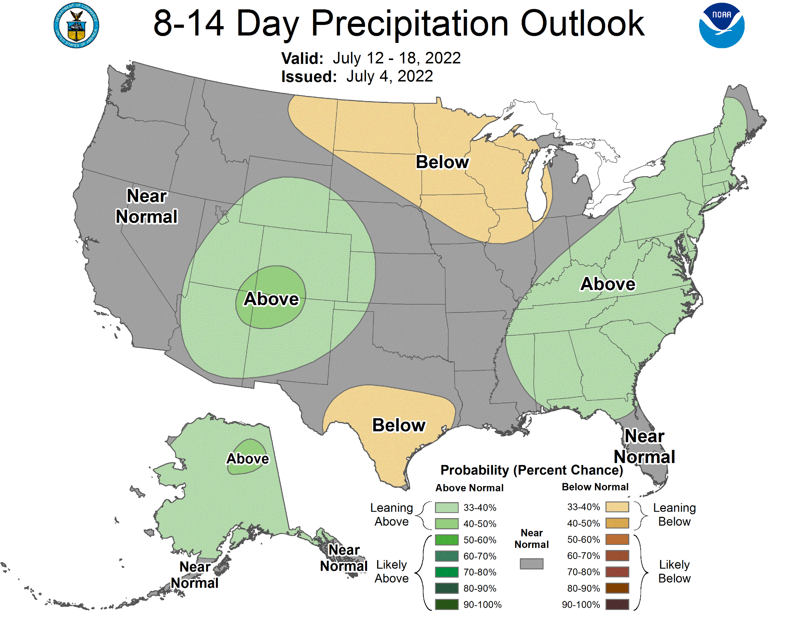
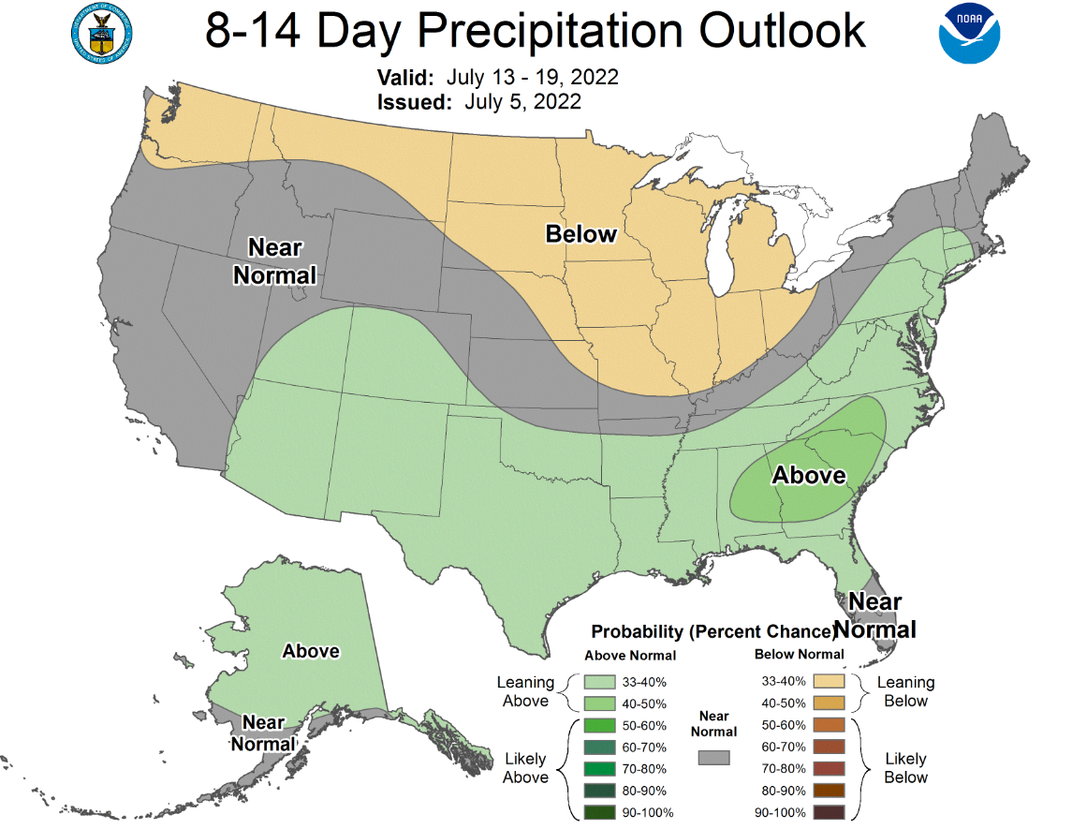
First … The 1-2 Week Forecast
Outlooks show that the Western US will likely have above normal temperatures for the next 2 weeks.

Slide 3
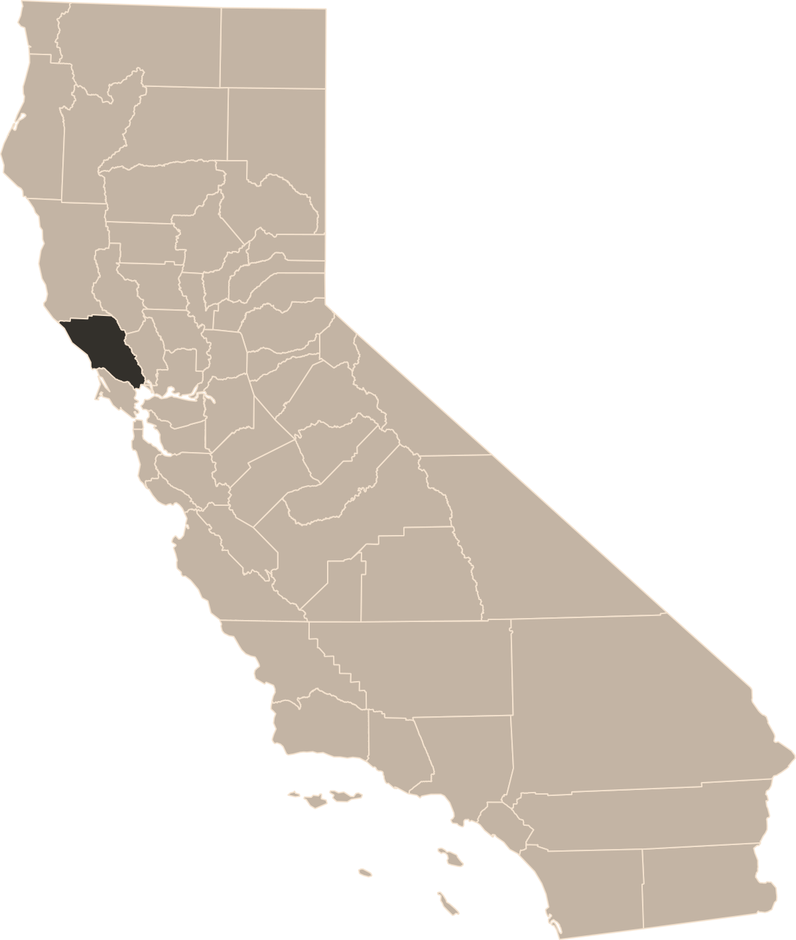
Current & Recent Drought Situation
STS Airport: 31.59” annual avg
2018-2019 – 48.17”
2019-2020 – 19.35”
2020-2021 – 13.01”
2021-2022 – 26.17” thus far, should be 31.43”
Healdsburg: 41.14” annual avg
2018-2019 – 45.35” (missing DJF)
2019-2020 – 19.86”
2020-2021 – 15.91”
2021-2022 – 28.96” thus far, should be 41.03”
Petaluma: 25.53” annual avg
2018-2019 – 33.46”
2019-2020 – 14.70”
2020-2021 – 8.76”
2021-2022 – 19.55” thus far, should be 25.41”
Past 3 Water Years (Oct 1 – Sep 30) have been below normal
Notes:
Climate normal should be 1991-2020
STS years of data (1999-2021)
Downtown Santa Rosa (1991-2012 & 2018-2020)

Slide 4
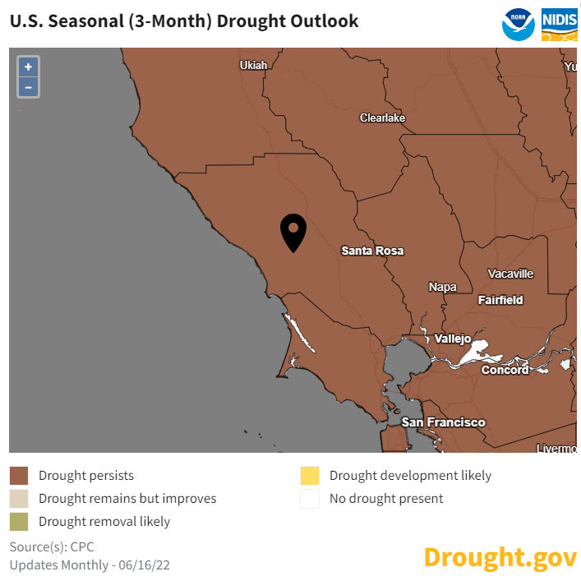
Drought Seasonal Outlook
We naturally don’t get much rain in the summer, so drought will persist
Only sources for moisture during summer:
Coastal Fog/Drizzle
Monsoon Thunderstorms

Slide 5
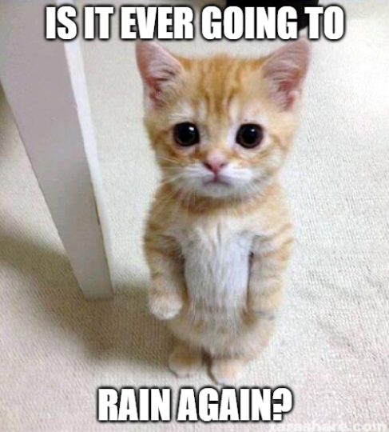
What to expect this winter
Soooo….
What’s going to happen this winter?

Slide 6
Warning – science graphs coming
Incoming
Sciencey
Graphical
Thing-a-ma-jigs

Slide 7
Quick Review ENSO = El Niño Southern Oscillation
Typical El Niño Winter
Jet Stream carries most winter storms to SoCal
Typical La Niña Winter
Jet Stream carries most winter storms to PacNW

Slide 8
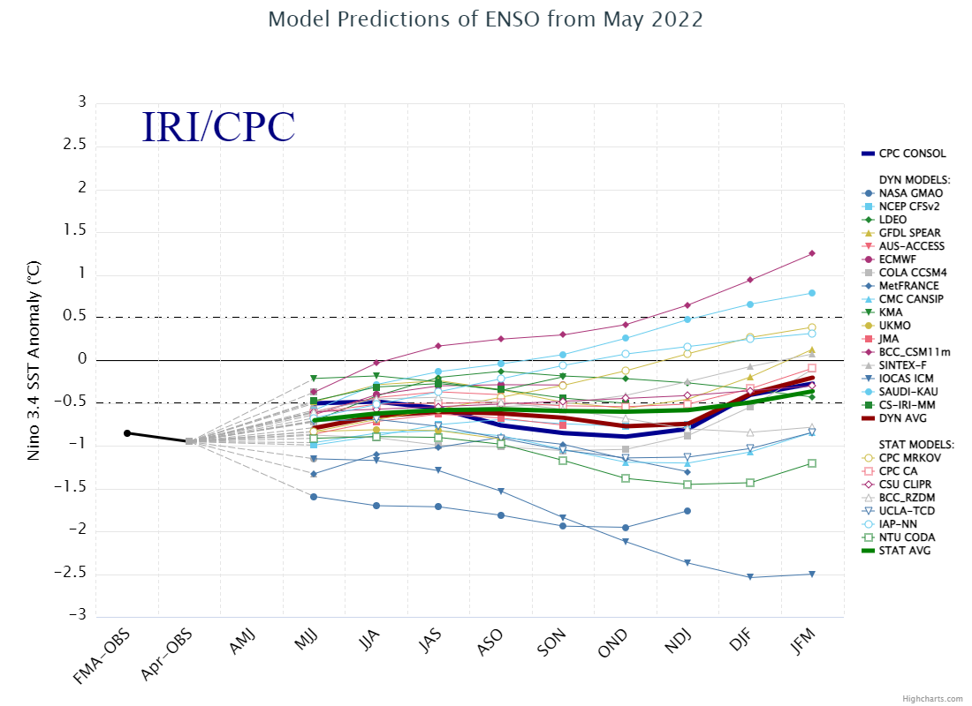
Model predictions of ENSO from May 2022
~ 60% chance for La Niña this fall into early winter
Next ENSO update from the Climate Prediction Center: July 14
Official Winter Outlook is in October
EL NIÑO
If the neutral trend holds during Dec-Jan-Feb,
then it may give us a better chance for normal precipitation.
NEUTRAL
LA NIÑA
Apr
Oct-Nov-Dec
Dec-Jan-Feb
May-Jun-Jul
Aug-Sep-Oct
Jun-Jul-Aug
Jul-Aug-Sep
Sep-Oct-Nov
Nov-Dec-Jan
Jan-Feb-Mar
Notes:
IRI = International Research Institute for Climate
0.5-1 is weak, 1-1.5 is moderate, 1.5+ is strong ENSO

Slide 9
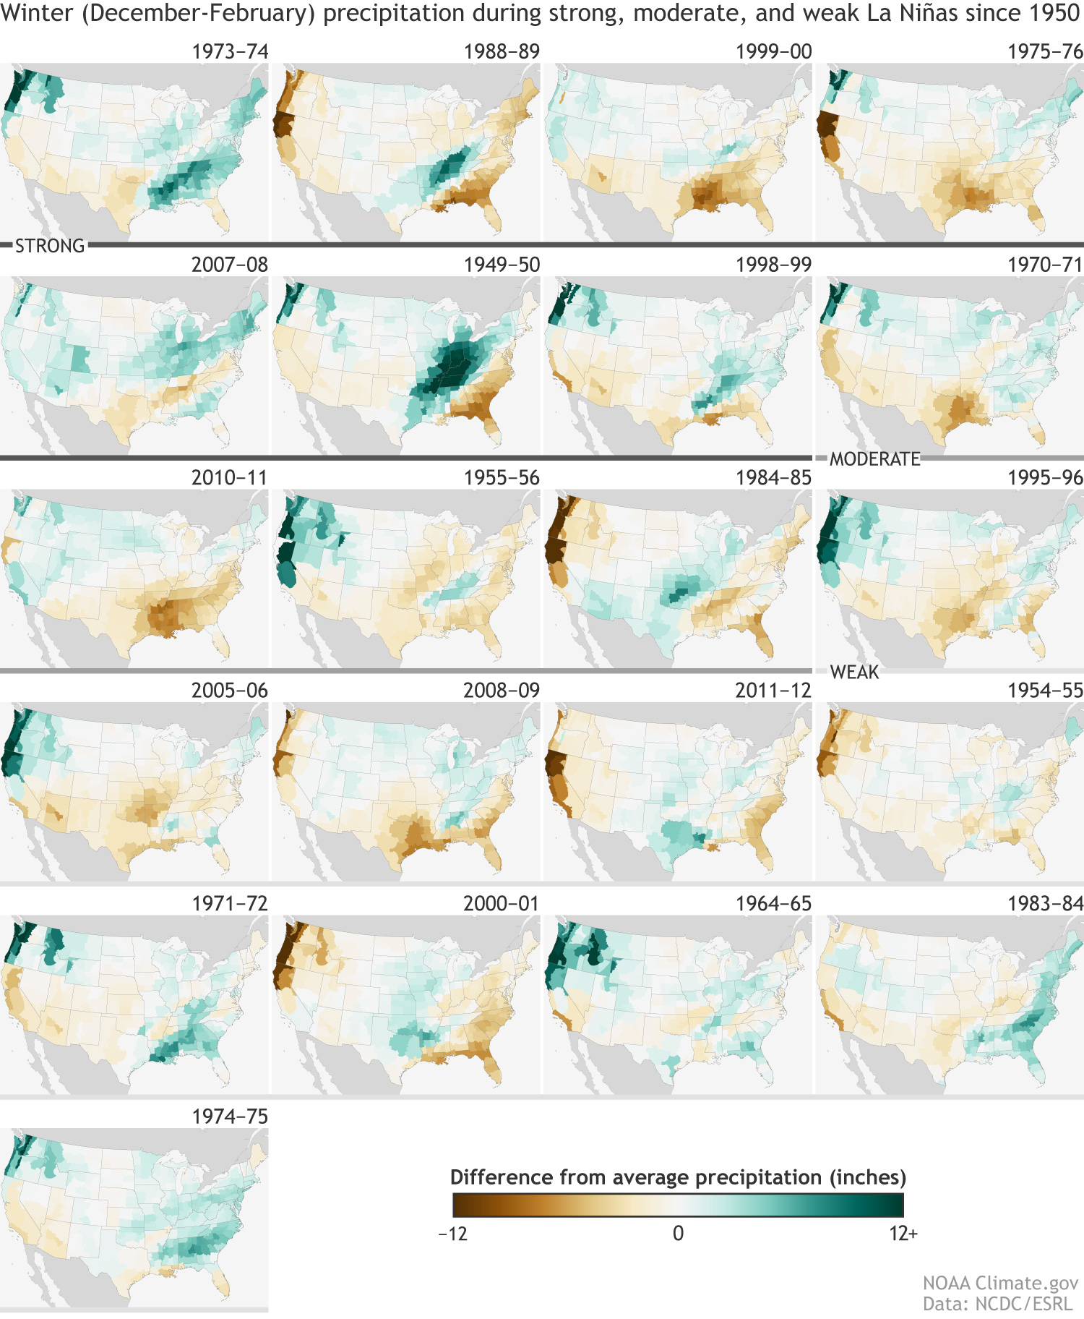
BUT…not all La Niñas are the same
Northern CA can have below or above average precipitation during
La Niña Winters
Variability is due to:
Weak, Moderate, Strong La Niña signals
Influence of other atmospheric oscillations with ENSO
NorCal is in between the typical El Niño (SoCal) & La Niña (Pac NW) impacted areas

Slide 10
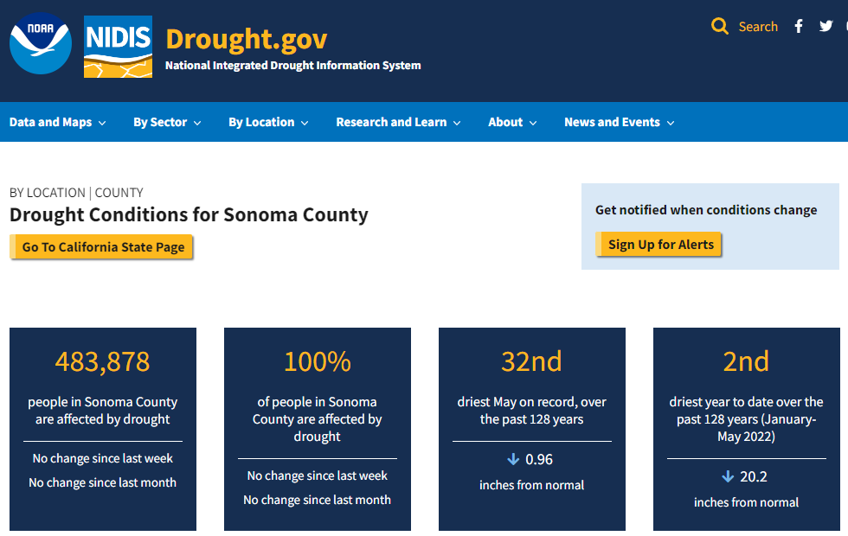
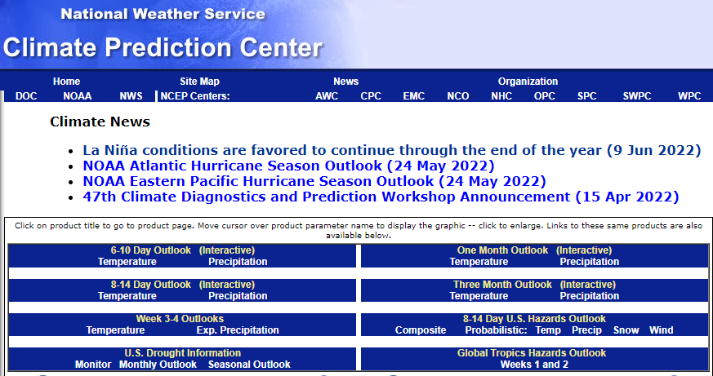
Resources
www.drought.gov/states/California/county/Sonoma
To learn more: www.climate.gov
Latest CPC outlooks: www.cpc.ncep.noaa.gov

Slide 11
Key Take-Aways
Approximately a 60% chance for La Niña this fall into early winter.
Will need to monitor the La Niña or Neutral trend for Dec-Jan-Feb (wettest months). If La Niña continues, this will be the 3rd winter in a row which is rare.
Official Winter Outlook will be in October.
Variability can happen in La Niña so be prepared for dry and wet months during winter.

